Slide 1



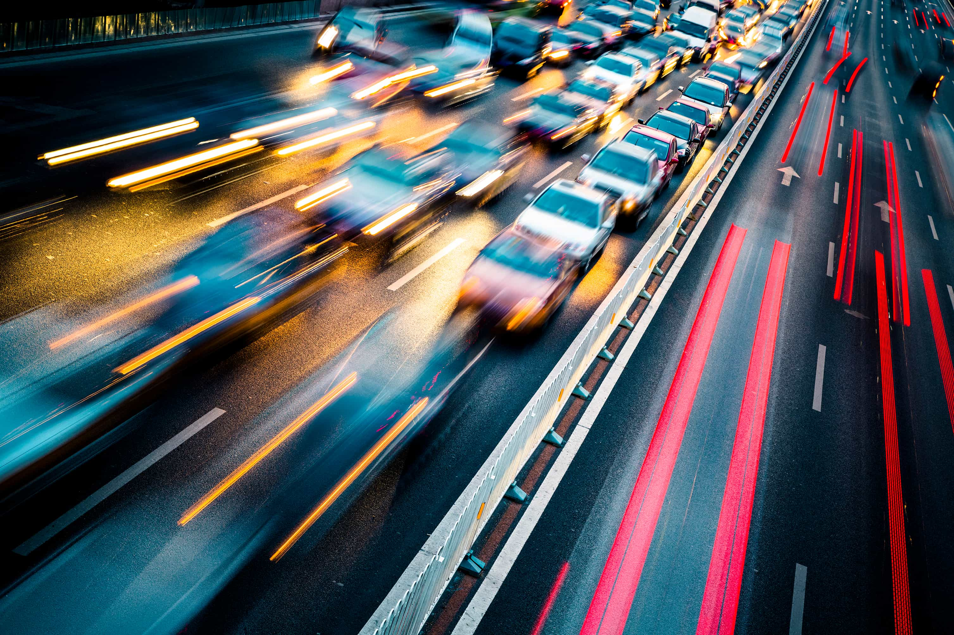

VIII Semester Internship End Term Presentation
Speed Estimation of Vehicles Using Deep Learning
This presentation focuses on the Speed Estimation of Vehicles using Deep Learning through YOLO v8 and ByteTrack
multi-object tracker.
by Armaan Sidhu
209301656, I Section

Slide 2

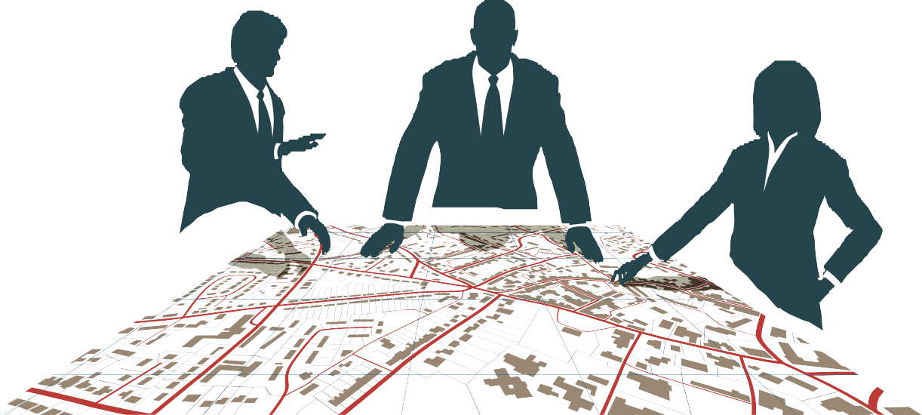
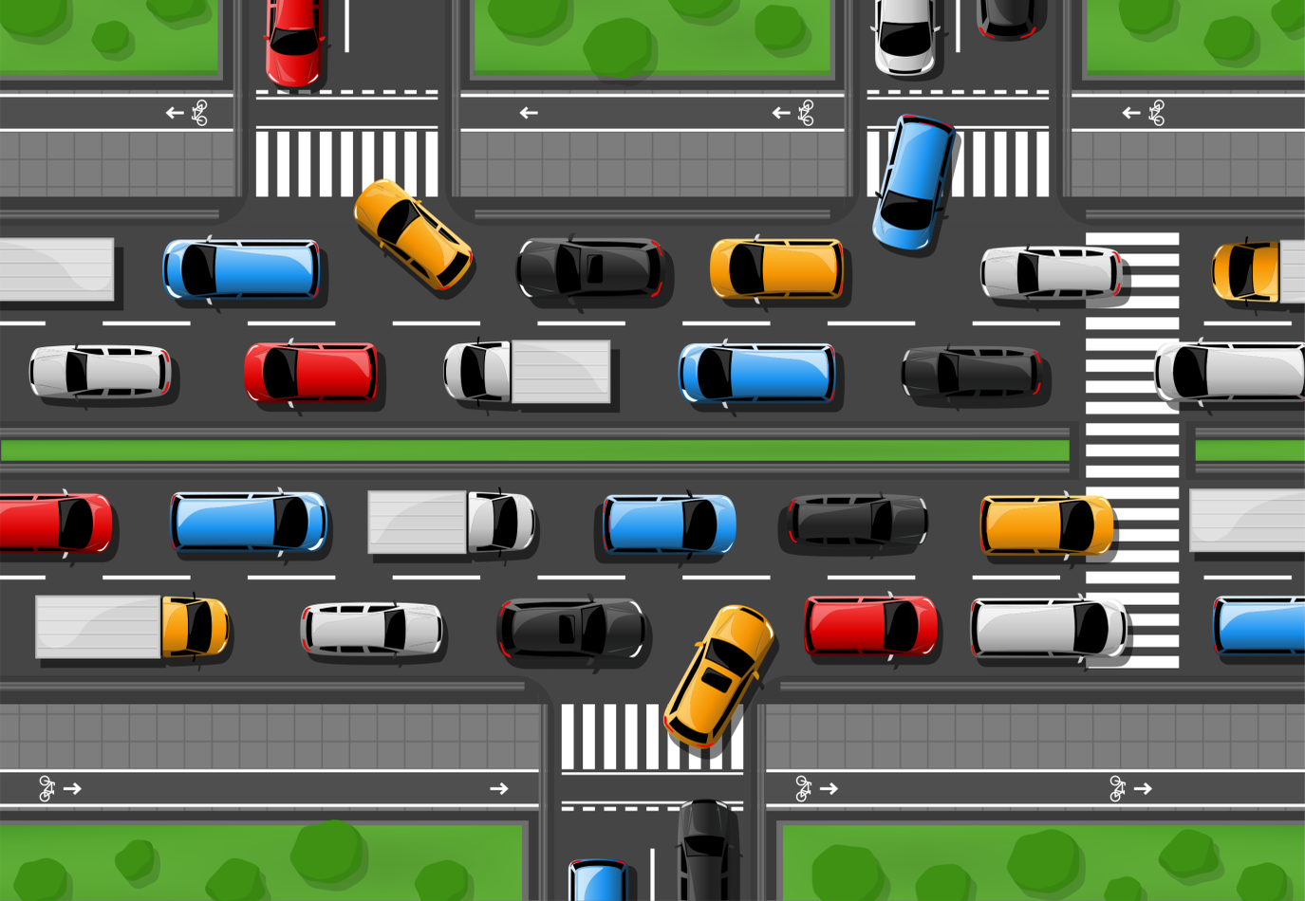





About AtlanZ Mobility
No data about traffic conditions to take informed decisions
Cannot take any action to solve traffic in real time
Government Authorities
Traffic Vehicles
Authorities can't communicate with citizens
Citizens are not able to tell their problems to authorities
No knowledge and awareness about rules and regulations
Problem - Current Traffic Management System
Citizens

Slide 3
Some Facts and Numbers
$ 2,000,000,000+
1.3,000,000+
Traffic jam in just four metro cities costs India a whopping $20 billion.
Every year the lives of approximately 1.3 million people are lost due to accidents.
3,500,000,000+
$ 3,000,000,000,000+
Globally, over 50% of the population lives in urban areas today. By 2045, the world's urban population will increase by 1.5 times to 6 billion
Over 3% of Global GDP of $100 Trillion+ is lost due to Traffic Congestions in the world

Slide 4
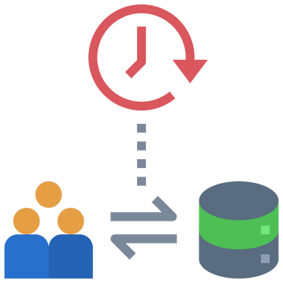

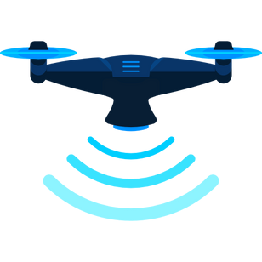

Solution: AI-powered Traffic Analytics Platform
AI based system which monitors, analyses and helps optimize the traffic.
Elimination of errors due to human interventions.
A system which will never stop solving and evolving.
Much Higher Quality of Data collection and storage
Real Time problem identification and solution Perform risk analysis and analysis by Drones
A communication channel between govt. authorities and citizens
Awareness about rules and regulations
Information made easily accessible.

Slide 5


Proof of Concept and Validation
Already tested on 4 different field conditions for accuracy
Very soon deployment in Surat City as a Pilot Project for Proof of Concept.
International Collaborations (Currently working with Technical University of Munich, Germany)
4 Research Papers under review to be published at reputed journals

Slide 6
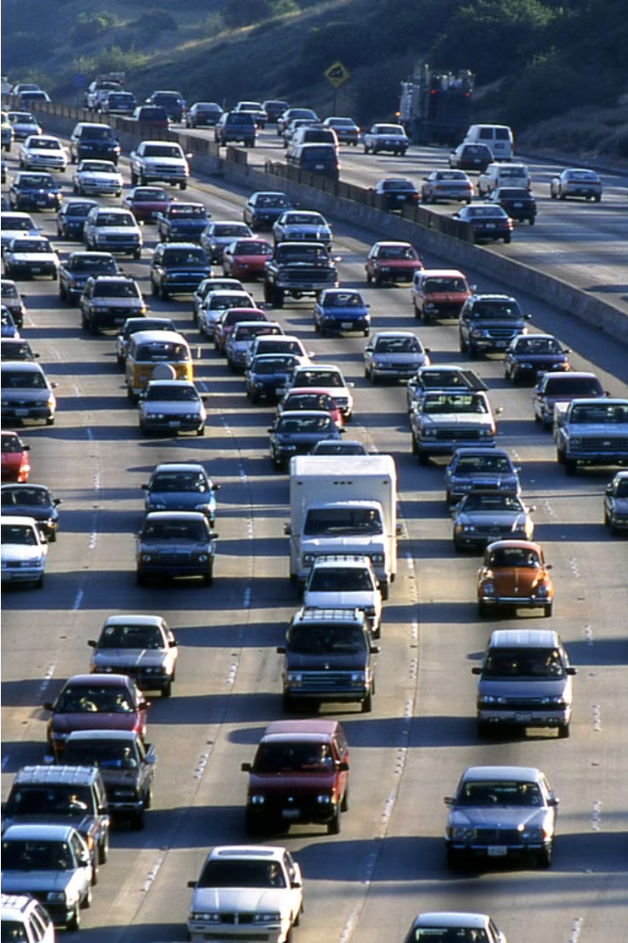
Introduction to Project
Vehicle speed estimation is a critical component of intelligent transportation systems, enabling applications such as traffic management, surveillance, and road safety enhancement. This project aims to revolutionize speed estimation from video footage by harnessing the power of deep learning techniques.
By integrating the YOLO object detection model and the ByteTrack object tracking framework, the system can seamlessly detect, track, and calculate the speeds of vehicles in real-time, overcoming the limitations of traditional methods. The fusion of these cutting-edge technologies promises to transform the landscape of transportation management and road safety, contributing to a safer and more efficient future.

Slide 7
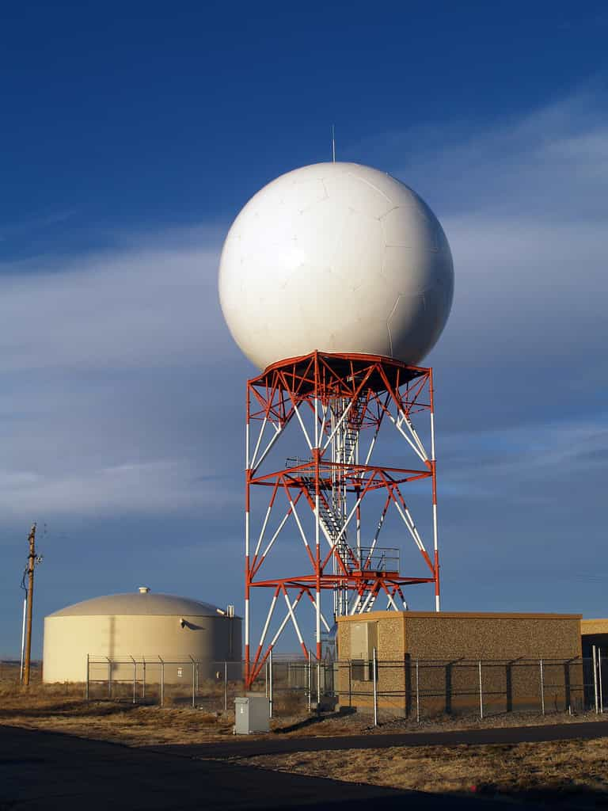
Issues with Traditional Approaches
Manual Analysis
Specialized Sensors
Limitations in Adaptability
Traditional methods of vehicle speed estimation often rely on manual analysis of video footage or sensor data. This approach is time-consuming, labor-intensive, and prone to human error, limiting its scalability and effectiveness in dynamic real-world scenarios.
Specialized sensors, such as inductive loop detectors and Doppler radars, can provide accurate speed measurements, but they are expensive to install and maintain, restricting their widespread adoption.
Traditional methods often struggle to adapt to complex and changing traffic conditions, such as varying lighting, weather, and occlusions, hindering their ability to provide reliable and accurate speed estimation.

Slide 8
Harnessing the Power of Deep Learning
1
Convolutional Neural Networks (CNNs)
2
Recurrent Neural Networks (RNNs)
CNNs excel at image recognition and object detection, making them well-suited for identifying vehicles in video footage.
RNNs are particularly effective in handling sequential data, enabling them to track vehicle trajectories across multiple frames.
3
Real-time Performance
4
Adaptability to Variations
Deep learning models can operate in real-time, providing immediate feedback on vehicle speeds, a crucial requirement for applications like traffic management and collision avoidance.
Deep learning models can be trained to handle a wide range of scenarios, including occlusions, lighting changes, and diverse traffic conditions, improving their robustness and reliability.

Slide 9
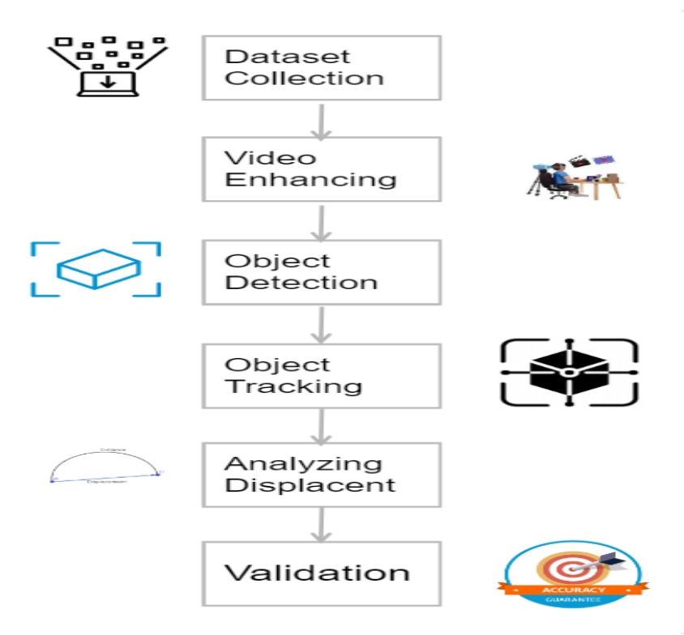
Methodology
1. Dataset Collection
2. Video Enhancing
A Dataset of video footage capturing various traffic scenarios, including different road types, weather conditions, and traffic densities is captured manually through drones
Raw video footage is pre-processed to enhance its quality, including tasks such as noise reduction, image stabilization, and contrast adjustment.
3. Object Detection
4. Object Tracking
YOLO v8 performs real-time object detection, identifying vehicles within each frame of the video and providing bounding box coordinates.
ByteTrack object tracking framework tracks the detected vehicles across consecutive frames, ensuring robust trajectory estimation.
5. Analyzing Displacement
6. Validation
The tracked trajectories are used measure the displacement over time accurately, enabling the calculation of vehicle speeds based on changes in position.
Evaluate the model using appropriate metrics such as Mean Absolute Error (MAE) and Root Mean Square Error (RMSE) against ground truth data, ensuring accuracy and reliability.

Slide 10
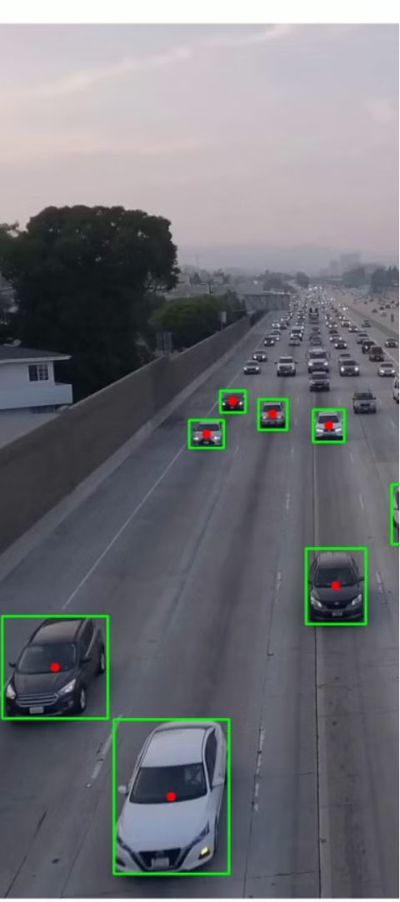
Integrating YOLO and ByteTrack
1
Vehicle Detection
The YOLO (You Only Look Once) object detection model is employed to identify vehicles within each frame of the video in real-time, providing the initial bounding box coordinates.
2
Vehicle Tracking
The ByteTrack framework seamlessly takes over, utilizing the bounding box information to track the identified vehicles across consecutive frames, maintaining the temporal coherence of the objects.
3
Speed Calculation
By analyzing the tracked vehicle trajectories and measuring the displacement over time, the system can accurately calculate the speed of each vehicle, enabling real-time speed estimation.

Slide 11
Enhancing Traffic Management and Road Safety
1
Traffic Optimization
2
Surveillance and Enforcement
3
Collision Avoidance
The accurate and real-time speed estimation provided by the integrated YOLO and ByteTrack system can contribute to the optimization of traffic flow, reducing congestion and improving the overall efficiency of transportation networks.
The system's ability to detect and track speeding vehicles can empower law enforcement agencies to identify potential threats, apprehend reckless drivers, and promote responsible road usage, enhancing public safety.
By providing immediate feedback on vehicle speeds, the system can contribute to the development of advanced driver assistance systems and autonomous vehicles, ultimately reducing the risk of accidents and promoting safer driving behaviors.

Slide 12




Features
Real-time Processing
High Accuracy
Adaptability
Scalability
The integrated system is designed to operate in real-time, enabling immediate speed estimation and feedback for critical applications.
The combination of YOLO and ByteTrack ensures accurate vehicle detection, tracking, and speed calculation, even in complex and dynamic environments.
The system is designed to handle a wide range of scenarios, including varying lighting conditions, weather, and traffic patterns, ensuring robust performance in diverse real-world settings.
The modular and open-source nature of the system allows for easy integration and scalability, enabling its deployment in various transportation and surveillance applications.

Slide 13
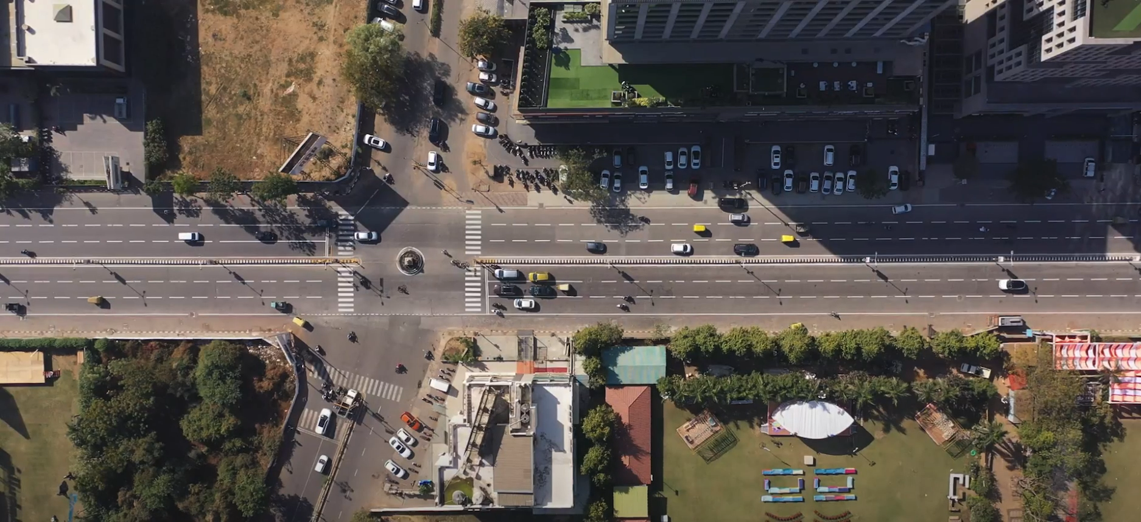
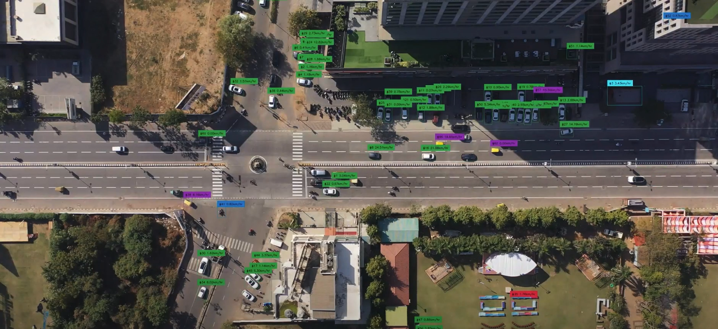
Footage of Results
Location📍 : Junction 7, Ahmedabad, Gujarat 🇮🇳
1
Input Video Stream
2
Output Video Stream
The input video stream depicts real-time traffic scenarios captured by drone. It serves as primary data for further processing.
The output video stream showcases the processed video with annotated vehicles and their respective speeds overlaid on each frame.

Slide 14
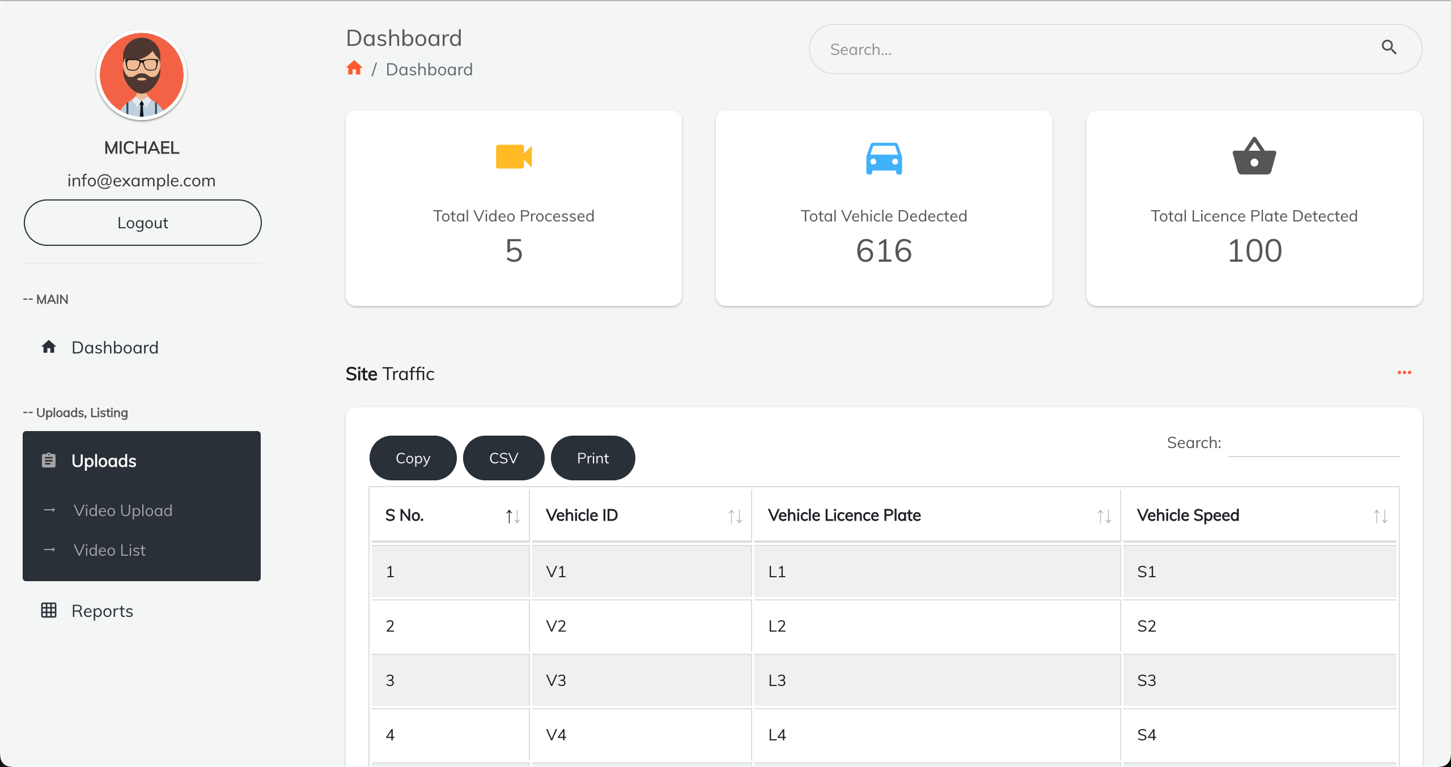
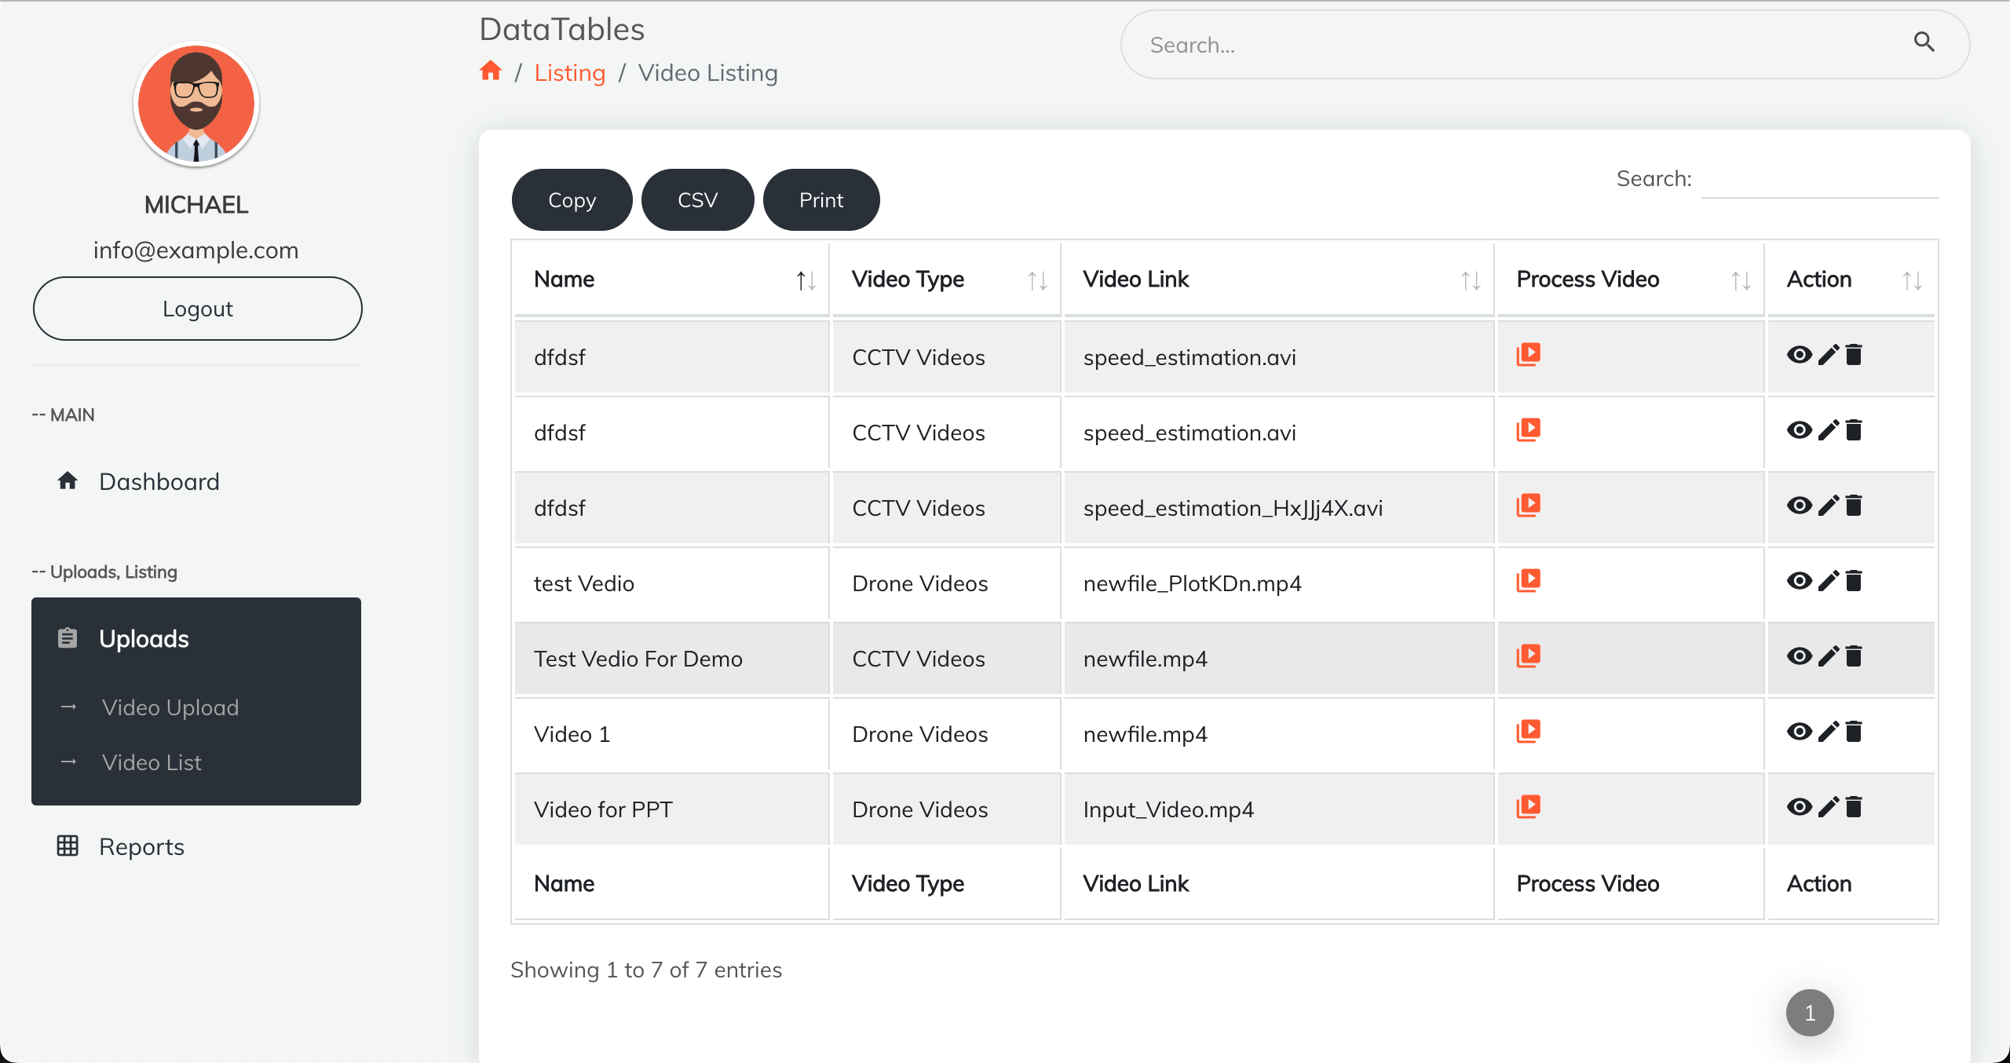
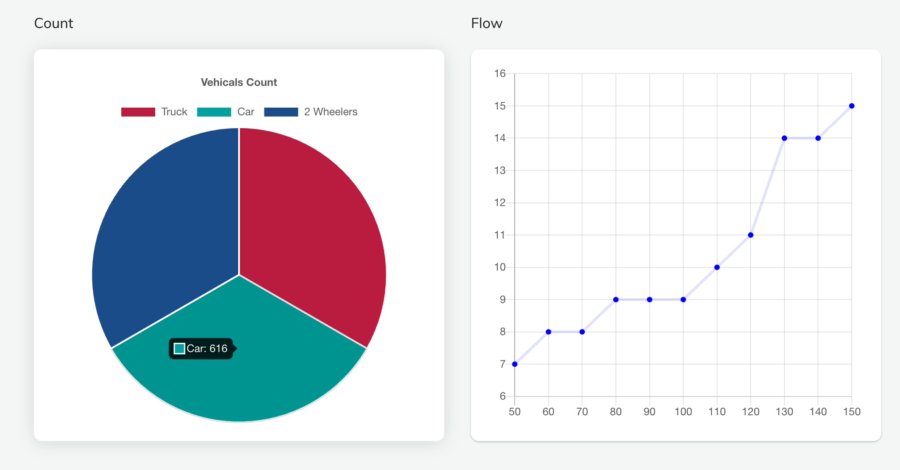
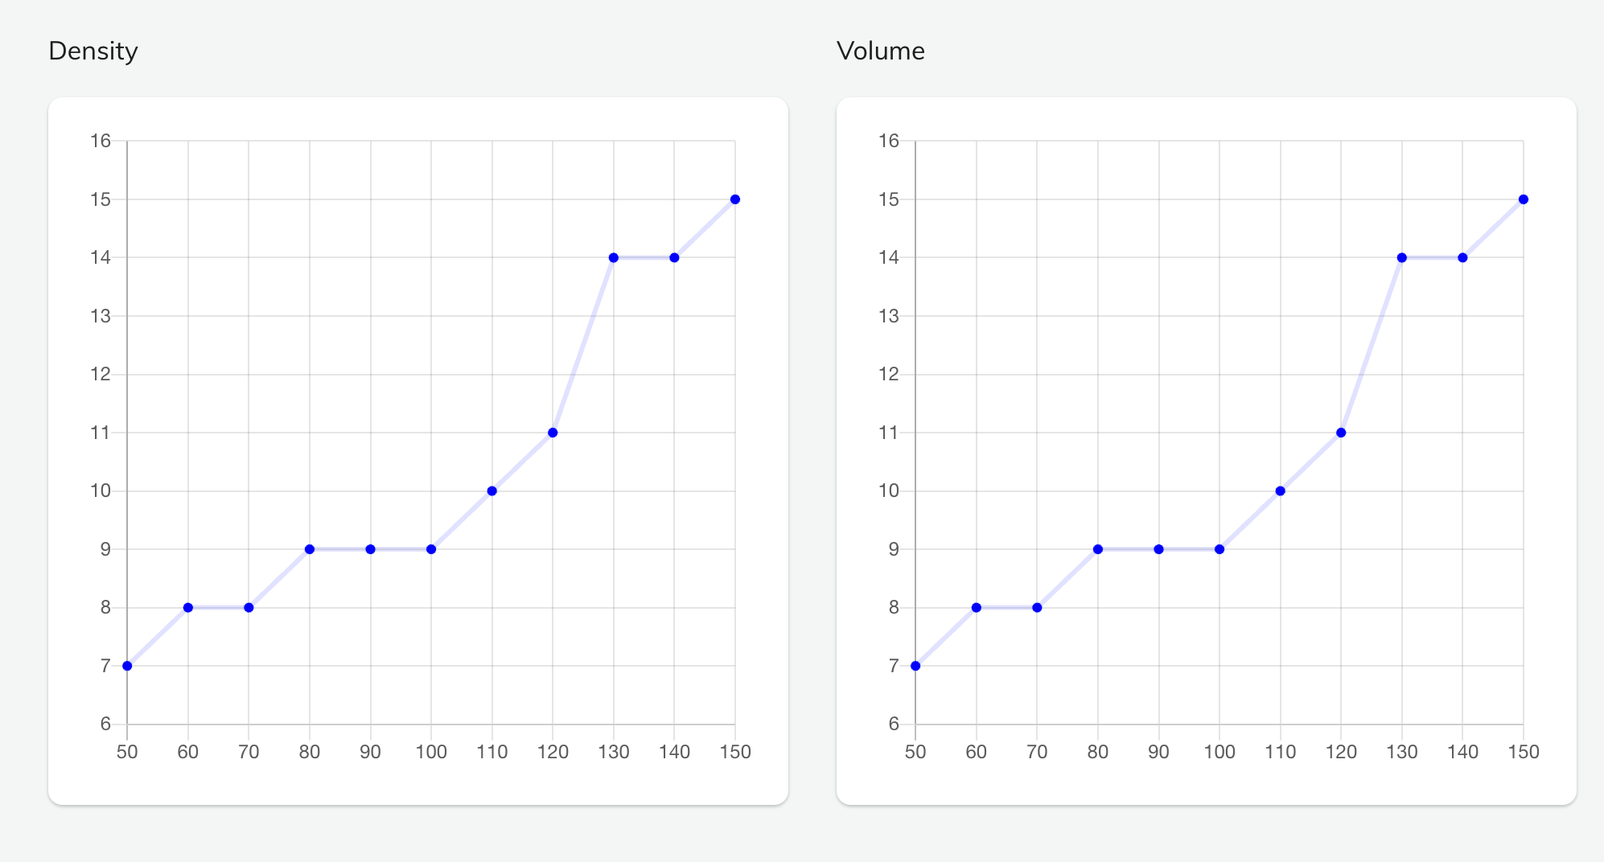
Dashboard Screenshots

Slide 15
Validation and Performance Evaluation
1
Metric
Value
2
Mean Absolute Error (MAE)
2.2 km/h
3
Root Mean Square Error (RMSE)
3.1 km/h
4
Mean Average Precision (mAP)
0.736
The performance evaluation of the integrated YOLO and ByteTrack system has demonstrated promising results, with a Mean Absolute Error (MAE) of 2.2 km/h and a Root Mean Square Error (RMSE) of 3.1 km/h in speed estimation.
The Mean Average Precision (mAP) of 0.736 further validates the system's ability to accurately detect and track vehicles. These metrics highlight the effectiveness of the deep learning-based approach in providing reliable and precise speed estimation, paving the way for its integration into real-world applications.

Slide 16
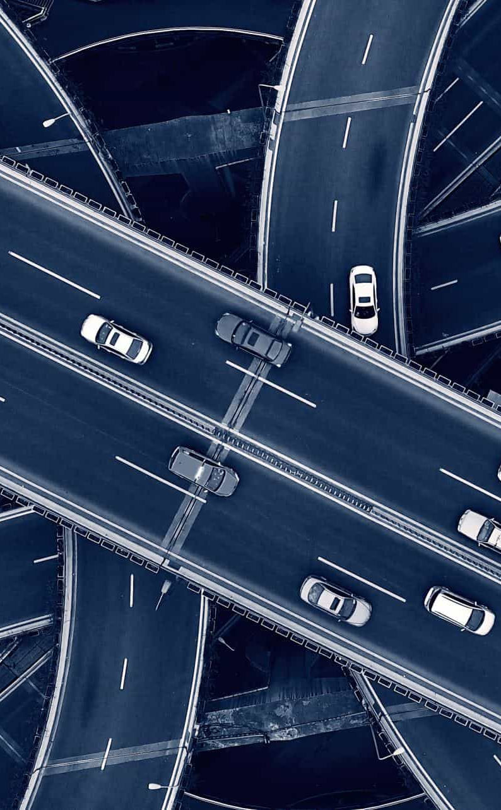
Addressing Challenges and Future Directions
1
Improving Accuracy
Ongoing research efforts aim to further enhance the accuracy of speed estimation by exploring advanced deep learning architectures and incorporating additional sensor modalities, such as LiDAR and radar.
2
Handling Complex Scenarios
Adapting the system to handle dynamic traffic conditions, diverse road geometries, and varying environmental factors will be a key focus to ensure its robustness and widespread applicability.
3
Privacy Preservation
Developing privacy-preserving techniques for vehicle speed estimation will be crucial to address ethical concerns and enable the widespread adoption of the technology.

Slide 17
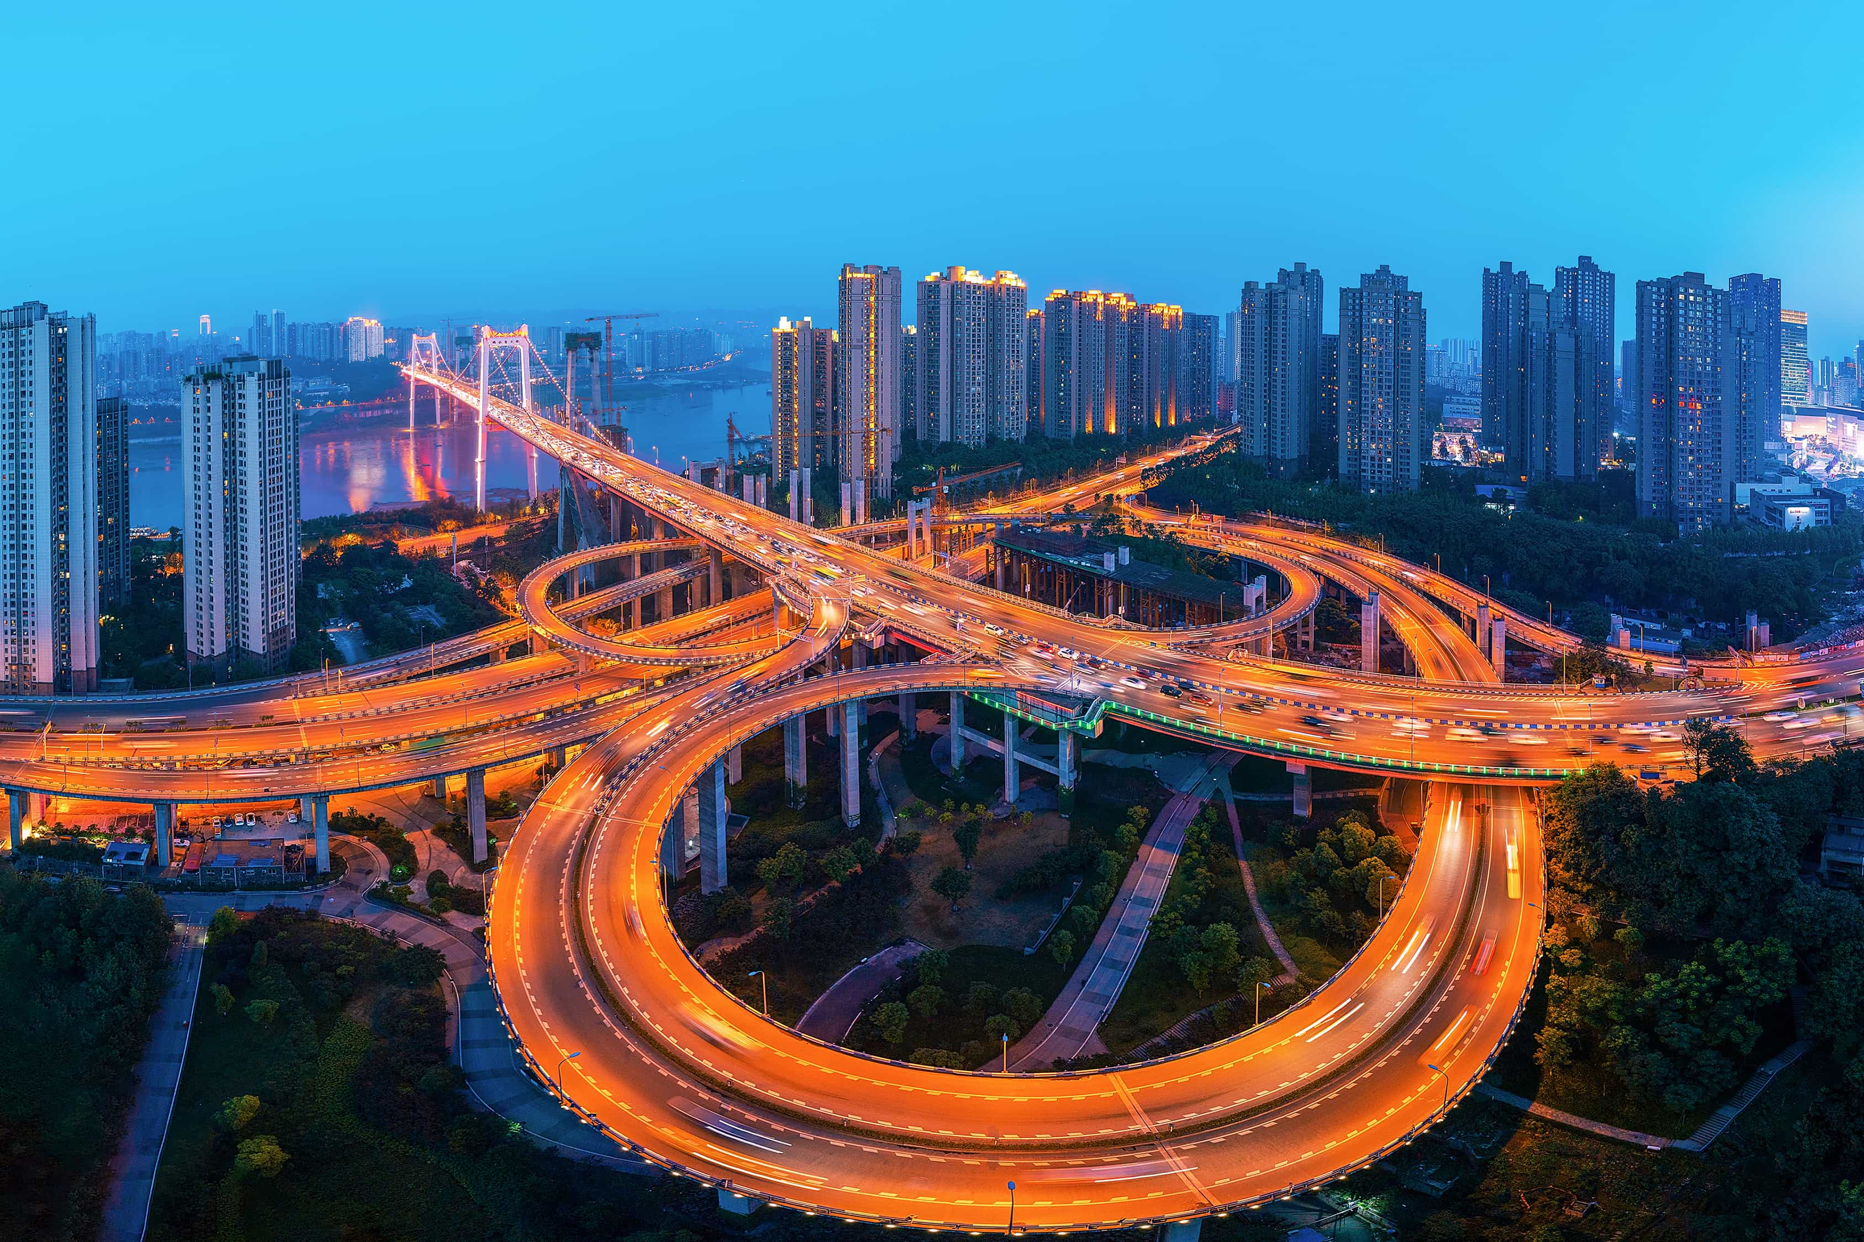
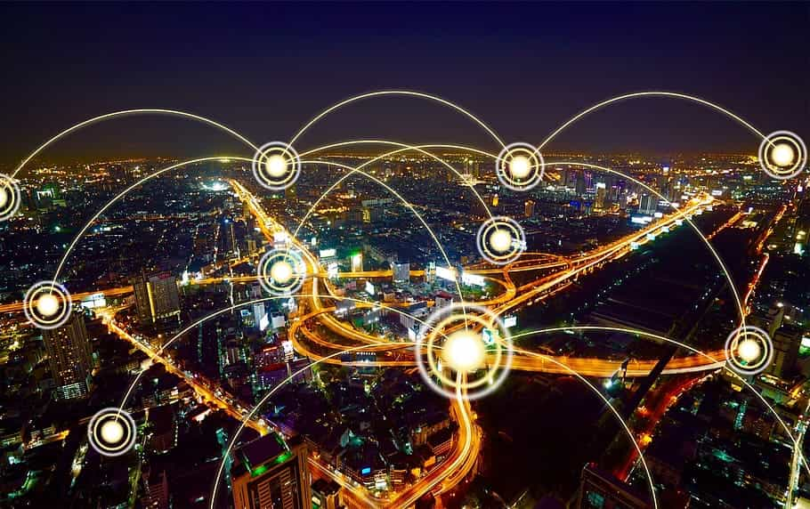


Future Prospect and Industry Impact
1
Real-time Traffic Management
2
Smart City
Infrastructure
3
Insurance and Risk Assessment
4
Environmental
Impact
By providing real-time data on vehicle speeds and traffic patterns, these interchanges can dynamically adjust signal timings, lane configurations, and routing strategies to optimize traffic flow, reduce congestion, and enhance overall roadway efficiency.
By providing real-time insights into traffic flow and congestion patterns, these systems enable cities to optimize transportation networks, reduce emissions, and enhance overall urban livability.
Insurance companies can leverage real-time speed data to tailor policies, incentivize safe driving behaviors, and mitigate risks associated with accidents and vehicle damage.
Through minimizing idling times and reducing fuel consumption, these systems contribute to lower emissions, improved air quality, and a more sustainable transportation ecosystem.

